Slide 1

The Art of SLOs
In the midst of chaos, there is also opportunity reliability
— Sun Tzu, The Art of War
Notes:
Self link: https://cre.page.link/art-of-slos-slides
Participant Handbook: https://cre.page.link/art-of-slos-handbook
Facilitator Handbook: https://cre.page.link/art-of-slos-howto
SLO Worksheet: https://cre.page.link/art-of-slos-worksheet
Errors in the content? https://cre.page.link/art-of-slos-bug
Want to improve this? https://cre.page.link/art-of-slos-improve
Want to ask a question? https://cre.page.link/art-of-slos-help
Instructors: You'll need to print out enough copies of the handout that all attendees can have one each, and enough copies of the SLO worksheet to cover the activities, which will probably work out as 5-6 copies of the worksheet per group.
This is the presentation for a ~3.5 hour SLO workshop, for use at e.g. conferences or with multiple attendees from different companies. Attendees are expected to be relatively comfortable with SLO terminology: this workshop tries to be activity-driven, though we still cover a reasonable amount of theory.

Slide 2
Welcome!
Don't be shy … say hello to your neighbours
Notes:
Goal: Introduce whoever's going to be on the stage. Context on the presenters is valuable for the audience!
Instructors: Have everyone introduce themselves to the rest of their table. Remember that many people in the room will be professional introverts and this may fill them with dread ;-)
Words:
We've found that people are a bit scared of interacting and asking questions in such a large room with so many people. Breaking the ice and introducing yourselves to each other is critical to open communication: you're going to be working with each other this afternoon, and there's plenty of evidence from disciplines like aviation and medicine that you'll all get on better if you're not complete strangers. Please take some time to turn to the folks on your left and right and tell them your name and a bit about you!

Slide 3
Group Agreements
We’re here to learn
Please ask questions (raise your hand)
One speaker at a time
Assume positive intent
“Why am I speaking?”
Notes:
Goal: Lay down workshop community guidelines.
Words:
Let’s set some expectations for interactions during the day.
First, we’re all hopefully here to learn. Please be mindful of distractions like laptops and phones.
Please ask questions when you’re not sure about something; we’ve budgeted time for it, so use it.
Also, hopefully none of what we discuss today is too contentious, but let's be mindful of our large audience. Please, let’s only have one person speaking at a time, and assume positive intent from the other learners here. We want to hear your questions and comments, but try to keep them focused on the material.

Slide 4
Agenda
Terminology
Why your services need SLOs
Spending your error budget
Choosing a good SLI
Developing SLOs and SLIs
Notes:
Goal: Lay out what's going to happen during the workshop.
Words:
In this workshop, we'll be talking about ways to quantify the reliability of a service and set achievable targets for that reliability. We need a common vocabulary to anchor this discussion, so we are going to start off by briefly covering how Google talks about reliability concepts and the terminology we're going use, such as Service Level Objectives and Service Level Indicators—SLOs and SLIs.
Then, we'll discuss what reliability means, why it matters to your users, and why there's such a thing as being "too reliable". We'll show how setting a target for the reliability of your service gives you a safety margin of allowable errors, and how the goal of staying within that margin aligns incentives across your organization.
Hopefully that part of the workshop will convince you that SLOs are a necessary component of any service. So: how do you figure out what SLIs and SLOs you should have for your service? For the rest of the workshop, we're going to spend some time developing SLOs and SLIs for an example service. We'll walk through the process once as a group, then you'll split up and tackle some more complex user journeys in small groups.
By the end of this workshop, we want you to be confident that you can take these concepts and tools and apply them to your own services and your own organization. If you think of any questions along the way, don't be afraid to speak up and ask!

Slide 5
Service Level Indicator
A quantifiable measure of service reliability
Notes:
Goal: Describe what this deck means when talking about service level indicators.
Words:
You're going to hear two terms a lot through this workshop: SLIs and SLOs. I'm sure many of you will have run into them before, but we're going to briefly touch on the concepts of what they are so we can be sure everyone here shares the same understanding.
Service Level Indicators (SLIs) are carefully chosen monitoring metrics that measure one aspect of a service's reliability. Ideally, SLIs should have a close linear relationship with your users' experience of that reliability, and we recommend expressing them as the ratio of two numbers: the number of good events divided by the count of all valid events.

Slide 6
Service Level Objectives
Set a reliability target for an SLI
Notes:
Goal: Describe what this deck means when talking about service level objectives.
Words:
A Service Level Objective (SLO) combines that SLI with a target reliability. If you express your SLIs as we've recommended, your SLOs will generally be somewhere just short of 100%, for example 99.9%, or "three nines".

Slide 7
Users? Customers?
Customers are users who directly pay for a service
Notes:
Goal: Disambiguate customers from other users.
Words:
Lastly, we'll end up talking about users and customers interchangeably during the workshop. We have an expansive definition of who your "users" are—they can be internal or external to your company, humans, other companies, or automated systems. Customers are the subset of your users who are paying directly for a service, with real money.

Slide 8
Services Need SLOs
Notes:
Goal: Describe the thesis of the workshop: that services need SLOs.
Words:
Services need SLOs. It's quite a bold assertion, isn't it?
But this is why we're here … we want you to leave this workshop convinced that you should set SLOs for the services you are responsible for, with a good understanding of how to do this in practice.

Slide 9
Don't believe us?
"Since introducing SLOs, the relationship between our operations
and development teams has subtly but markedly improved."
— Ben McCormack, Evernote; The Site Reliability Workbook, Chapter 3
"... it is difficult to do your job well without clearly defining well. SLOs provide the language we need to define well."
— Theo Schlossnagle, Circonus; Seeking SRE, Chapter 21
Notes:
Goal: Demonstrate that other organizations do this too!
Words:
You don't have to believe us about the value of SLOs. In chapter three of the Site Reliability Workbook, you can read two case studies from large businesses that successfully introduced SLOs throughout their organizations. The book's now freely available so you won't even have to pay to do so! SLOs also feature heavily in David Blank-Edelman's excellent book "Seeking SRE". We've obviously cherry-picked the quotes here, but these case studies don't just demonstrate that SLOs bring long-lasting improvements to your business, they also provide blueprints and strategies for rolling out SLOs in your own company.

Slide 10
The most
important feature
of any system
is its reliability
➊
Notes:
Goal: Introduce a core assumption: service reliability is the #1 feature.
Points:
<read slide text>
Perception of unreliability ⇒ loss of trust
Words:
But ... why?
Why do we want you to believe that your services need SLOs? It stems from this driving principle: that the most important feature of any system is its reliability.
You can easily lose the trust and respect of your users if your service becomes too unreliable—or is simply perceived as being too unreliable. Those countless hours you've spent designing and building the most amazing user experiences are all for nothing if your users can't access them.
Unreliability can have disastrous consequences for your business. Competitors will snap up your current, dissatisfied users and your poor reputation will slow—or even halt—the acquisition of new users.

Slide 11
How do you incentivize
reliability?
Developers
Agility
Operators
Stability
Notes:
Goal: Break down organizational barriers by aligning incentives.
Points:
Tension between feature iteration speed and service reliability
Reliable operation means shared priorities and incentives
Now may be a good time to do a straw poll of your audience:
Who's heard of the term DevOps? Who thinks they understand it in the same way as the person next to them?
Who here does CI/CD? Who drops everything to fix the build when it turns red? Who's shipped something to hit a deadline, knowing it still had bugs?
Words:
It's not enough to just declare that your services must be more reliable. If that worked, you wouldn't be here listening to me.
Reliability is a shared goal that many different parts of your organization must work toward together. In many companies, it's common to separate out the responsibility for operating a service from that of building new features for it. This allows people in each role to specialize, but it alters their priorities in a way that can often cause conflict.
Who's experienced a story like this?
The development team for a service decides to focus on feature iteration speed, adopting practices like Agile development and push-on-green to accelerate planning and release cycles. This increases the burden on service operators, who are left scrambling to catch up with a steady stream of "beta" features making their way into production. Inevitably, something gets pushed before it's quite production-ready, leading to a very visible outage and lots of customers shouting on social media. The operations team reacts by setting up procedures to protect the production environment from all this terrible, outage-inducing change, slowing developers down and making them sad.
To avoid this scenario, your organization needs to find a way to incentivize the developers and operators of a service to cooperate, so that you can build new features without regularly suffering serious, reputation-damaging outages.

Slide 12

A principled way
to agree on the desired reliability
of a service
Notes:
Goal: Demonstrate the benefits of anchoring the reliability conversation on objective data.
Points:
What is "reliable enough"?
SLOs are a common language across the business
Value of SLOs to
development
operations
product
executive
Words:
But you can't spend all of your engineering time on reliability, because reliability is not a standalone product. So the question you end up asking is "What is reliable enough?" shortly followed by "How can I objectively measure the reliability of my service?"
That's why we think your services need SLOs. We think of SLOs as a principled way to agree on the desired reliability of a service.
SLOs provide different value to different parts of an organization. We've claimed reliability is the most important feature, but for many product-oriented folks, this brings up a difficult question: When should engineering for increased reliability take priority over that shiny new feature you've been designing for months? If you have an agreed-upon and widely-communicated target for service reliability, you can answer that question with objective data.
For developers in the room, reliability work can get in the way of hacking on cool new projects and meeting those crazy deadlines set by the product folks. Changing systems is the biggest risk to their reliability, so how can you strike a good balance between moving fast and breaking things? If you have a real-time measure of service reliability, you can start to gauge the reliability cost of new code. You'll know when one of your shiny new features has hurt your users instead of delighted them.
And for the ops folks, who are generally on the hook for a service's reliability, agreeing that some measure of unreliability is acceptable and even desirable usually helps reduce the overall operational burden of that service. Rather than burning yourselves out fighting every small fire, you can carve out time to work on proactive projects that stop things from catching fire in the first place.
So SLOs provide a common language and shared understanding, anchoring your conversation about service reliability on concrete data. It's tempting to consider SLOs to be a purely operational concern, but for them to function correctly as a signal for prioritization of engineering work, your reliability targets must be set in conjunction with engineering and product teams. Everyone must agree that the target accurately represents the desired experience of your users.

Slide 13
What does "reliable" mean?
Think about Netflix, Google Search, Gmail, Twitter…
how do you tell if they are ‘working’?
Notes:
Goal: Engage the room in a short discussion about what "reliable" really means.
Instructors: one suggested approach for the classroom:
Give one example, e.g. when you search on Google, you expect to get a list of results back that are relevant to your query.
Ask each table for one suggestion.
When you've got a bunch of suggestions, draw out the common themes of Availability, Latency, and Quality that will—hopefully—be suggested by the audience.
Finally, ask: How often would you be willing to tolerate these services failing to meet these expectations?
Words:
What do we mean by "reliable” in the context of an internet service? Let’s start by talking about what it means for a service to be “working well”—or indeed, just “working”.
What should you be able to do?
What characteristics are important to you?
What are your expectations of how the service should respond?

Slide 14


Objective
Agreement
0 ms
200 ms
300 ms
“Ugh”
“HTTP GET / …”
Customer
Notes:
Goal: Differentiate between SLOs and SLAs. Talk about SLOs as internal targets that drive prioritization.
Points:
Agreement is just enough to stop people leaving
Objective must be tighter than agreement
Objective should represent desired user experience
Breaching objective must also have consequences
Words:
If your service has paying customers, you probably have some way of compensating them with refunds or credits when that service has an outage. Your criteria for compensation are usually written into a Service Level Agreement, which describes the minimum levels of service that you promise to provide and what happens when you break that promise.
The problem with SLAs is that you're only incentivized to promise the minimum level of service and compensation that will stop your customers from jumping ship to a competitor. Customers often feel the impact of reliability problems before these promises are breached, falling far short of the levels of service that keep your customers happy and contributing to a perception that your service is unreliable.
Compensating your customers all the time can get expensive, so what targets do you hold yourself to internally? When does your monitoring system trigger an operational response? To give you the breathing room to detect problems and take remedial action before your reputation is damaged, your alerting thresholds are often substantially higher than the minimum levels of service documented in your SLA. SLOs provide another way of expressing these internal reliability targets.
For SLOs to help improve service reliability, all parts of the business must agree that they are an accurate measure of user experience and to use them as a primary driver for decision making. Your customers probably don't need to be aware of them, but they should have a measurable impact on the priorities of your organization. Being out of SLO must have concrete, well-documented consequences, just like there are consequences for breaching SLAs. For example, slowing down the rate of change and directing more engineering effort towards eliminating risks and improving reliability will get you back into SLO faster. Operations teams need strong executive support to enforce these consequences and affect change in your development practice.

Slide 15
With me so far?
Notes:
Instructors: Timing wise, you should be around 20ish-minutes in here. Pause for questions, but try to cut them off if they go on for > 5 minutes.

Slide 16
When do we need to make
a service more reliable?
Notes:
Goal: Introduce the next section on targets and error budgets with a question.
Points:
<read slide text> ⇒ How reliable is "reliable enough"?
Words:
One way of looking at an SLO is that it helps you answer this question, When do we need to make a service more reliable? But really, the question is, "Where do we draw the line?" Thus far, all we've established is that your SLO targets should be substantially higher than the reliability your SLAs promise. This doesn't help the many "free" services, funded by advertising, that don't have user-facing SLAs at all.
So, how reliable is "reliable enough"? How do we measure how far off that target we are? And what do we do if we figure out we're missing that target?

Slide 17
100%
100% is the wrong reliability target for basically everything
— Benjamin Treynor Sloss, VP 24x7, Google; Site Reliability Engineering, Introduction
Notes:
Goal: Rationalize an acceptable level of failure.
Points:
Even things like pacemakers are unreliable
Each nine is 10x more cost for 10x less benefit
Words:
You might think that you want to set your targets as high as possible, to serve your users as best you can. But no! The key realization that Ben Treynor Sloss, the founder of SRE at Google, had was that 100% is the wrong reliability target for almost everything^{[1]}. This is even true for supposedly reliable things like pacemakers, which, according to a paper^{[2]} published in 2005, had an average reliability of around 99.6% between 1990 and 2002! Making a service more reliable requires increasing commitments of both engineering time and operational support, for ever-decreasing improvements to overall reliability. At some point before you reach 100% reliability, that tradeoff is no longer worth making because the costs outweigh the benefits.
But how do we figure out where the optimal target is? In Google's case, we came to the conclusion that if we aimed to be slightly more reliable than the top consumer ISPs, our users would be substantially more likely to attribute random errors to failures at their ISP. Going back to our discussion of what "reliable" is: how do you normally check whether your internet connection is working? For most people the answer will be "load the Google homepage" or "ping 8.8.8.8".
[1]: https://landing.google.com/sre/interview/ben-treynor.html
[2]: "Pacemakers malfunction less often than defibrillators". AORN Journal. 82: 862. 2005—via https://en.wikipedia.org/wiki/Pacemaker_failure

Slide 18
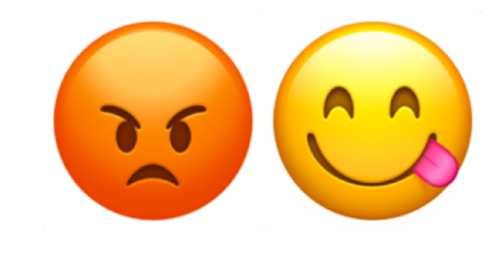
😡😋
SLOs should capture the performance and availability levels that, if barely met, would keep the typical customer of a service happy
“meets SLO targets” ⇒ “happy customers”
“sad customers” ⇒ “misses SLO targets”
Notes:
Goal: Describe the concepts underlying the happiness test.
Points:
SLO is the dividing line between happy / unhappy users
Beware of over-aggregation, your users are not all the same
Words:
We have a simple rule of thumb for where SLO targets should be, that generalizes the case: a typical user of your service should be just about happy with the service, when it operates at those targets. If the service was any less reliable, you'd no longer be meeting their expectations and they would start to become unhappy. We call this the "happiness test".
The challenge is quantifying and measuring that happiness, because measuring it directly tends to require the kind of invasive medical procedures that customers are unwilling to consent to. It's bad if you're meeting all of your SLOs and customers are unhappy. You have to make sure you're thinking about all groups of your customers: mobile, desktop, different geographies, etc. The impact of an outage may not be spread equally but SLOs are generally aggregates across your user base; if one customer is getting all of your error budget, they will probably not be happy.
One particular group of users you may need to treat differently are those who work at your company. They'll often have insights into the operation of your services that others might not. This may cause them to behave in unexpected or downright strange ways from the perspective of your service, especially if they're granted early access to new features for testing purposes.

Slide 19


Measure SLO achieved & try to be slightly over target...
SLI
Target
Notes:
Goal: Make it clear that there's such a thing as "too reliable".
Points:
Being too reliable wastes effort that could have been used to build features
Words:
When we talk about the happiness test, we say "barely met" because there are downsides to exceeding your reliability target, too. Once your users are happy with the reliability of your service, additional reliability has little value. Maybe your users would be happier if you built new features or made other service improvements with the resources you're dedicating to far exceeding your reliability targets.

Slide 20
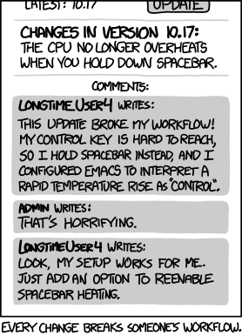
SLI
…but don’t be
too much better
or users will
depend on it
!
Target
"Workflow", Randall Munroe, XKCD
Source: https://xkcd.com/1172/
Notes:
Goal: Raise the specter of implicit SLOs.
Points:
Being too reliable anchors your users’ expectations
If this is just a run of good luck, you'll be in trouble at some point
Words:
The worst part is that if you’re consistently well over-target for your SLO, your users will eventually come to expect the service to be that reliable all the time. A common way for this to occur stems from factoring the risk of rare-but-damaging events into your SLO targets. If these events don't happen for a long time, through the combination of good operational response and better luck, you'll be in for a bad time from your users when they do finally occur. Your users' expectations form a kind of implicit SLO that you won't even know exists until they unexpectedly start complaining.
(see also Hyrum's Law)

Slide 21
Error Budgets
An SLO implies an acceptable level of unreliability
This is a budget that can be allocated
Notes:
Goal: Describe how to use acceptable unreliability as a budget.
Words:
If we're not targeting 100% reliability, then whatever target we do set implicitly allows for a small amount of errors to be served to users. If everyone agrees that the SLO target represents the point at which users start to become unhappy with the reliability of the service, we can theoretically serve errors beyond that point without impacting user happiness. For example, if you set a three nines target, that means you can serve one error in every 1000 requests to your users. Or, in terms of complete downtime, your service can be unavailable for a little over 40 minutes in a four-week period. Rather than just passively measuring the SLO—and potentially exceeding it substantially—we can treat the acceptable unreliability as a budget that we can spend on various development and operational activities.

Slide 22
Implementation Mechanics
Evaluate SLO performance over a set window, e.g. 28 days
Remaining budget drives prioritization of engineering effort
Notes:
Goal: Explain the role of measurement windows in turning SLOs into error budgets.
Points:
Converting SLO target → error budget requires a time window
Calendar vs. rolling windows
Recommend 28 days, exactly 4 weeks ⇒ no variation from weekly release cycles or weekends
Words:
Figuring out how much budget you've got available from a percentage reliability target means specifying a time window for the events your SLI is measuring. Within Google, we often use fixed, quarterly SLO windows for reporting purposes, and we've seen this pattern at many of our customers’ too. The problem with fixed, calendar-oriented windows is they refill your error budget in one large step as the window rolls over. This makes them unsuitable for operational purposes—your customers are still going to remember yesterday's massive outage on the first day of the new quarter, but your budget has been reset, so everything's fine, right?
Instead, we use shorter rolling windows to drive decisions about operational priorities. Cloud services use a 30-day rolling window, but we generally recommend 28-day rolling windows for new SLOs. Since it's exactly 4 weeks, there's no variation introduced by having five "release days" within the window when you are doing weekly software releases, or five weekends within the window. We also use very short-term rolling windows like 1 or 12 hours to drive alerting­—if you burn multiple hours of error budget within an hour, you can be relatively certain that an operational response is necessary!
Once you've decided on the time window, you count the number of events within that window. Multiplying this by the SLO target yields the absolute minimum number of good events that must be served within the window to meet the SLO, which in turn tells you the allowable number of bad events—the error budget. When you subtract the actual number of bad events, you know how much error budget you have remaining. This is a key signal to feed into your project planning cycle: if you have plenty of budget to spare, you can take more risks and move faster, but if you've already used most of your budget, that's a signal that you need to start prioritizing and fixing those pesky bugs instead of building that cool new stuff. If you are way over budget, your users are unhappy and you urgently need to start trading feature velocity for reliability work.

Slide 23
ITIL Approximation
Service in SLO → most operational work is a standard change
Service close to being out of SLO → revert to normal change
(No, I don't understand the difference between "standard" and "normal" either…)
Notes:
Goal: Relate error budget mechanics to ITIL change management.
Words:
For those of you coming from more structured environments, we've found this approximation works well when trying to fit SLOs into the world of ITIL change management. When a service is in SLO, the developers and operators have much more leeway to make changes to the service without going through potentially lengthy review and approval processes, something ITIL calls a "standard change". If the service is running low on error budget and looks like it may exhaust it in the near future, those processes kick back in again to catch any changes that might result in burning the rest of the budget. Confusingly, ITIL calls this "normal change".
See also:
http://itsmtransition.com/2014/03/name-difference-standard-normal-changes-itil/
http://www.itilfromexperience.com/People+are+confused+between+a+normal+and+a+standard+change.+What+is+another+name+for+it

Slide 24
What should we spend
our error budget on?
Notes:
Goal: Transition from error budget mechanics to error budget usage.
Words:
This all leads us to ask: What should we spend our error budget on? For large services, we generally expect that some of it will be burned by a background rate of failures, but if we're making a conscious decision to allocate this budget to development or operational activity, what kind of activity are we talking about?

Slide 25
Error budgets can accommodate
releasing new features
expected system changes
inevitable failure in hardware, networks, etc.
planned downtime
risky experiments
Notes:
Goal: Enumerate various ways to spend error budgets
Words:
At Google, we've observed that the two biggest factors that burn error budget are software releases and configuration changes. This is why we often recommend that a reasonable consequence of burning all your error budget is to slow down or even completely stop making non-essential changes to a system until the service is back within SLO.
Of course, sometimes things just break, and it's a good idea to make sure you keep some slack in your budget allocations to account for emergencies and unforeseen circumstances.
If you have to take a service down for essential maintenance, you can pay for it with downtime from your error budget, though if the downtime is communicated enough in advance, your users should be expecting it and therefore less unhappy about it.
Lastly, one useful thing to spend small amounts of error budget on is experimentation. The ideal is that your SLO target represents the dividing line between happiness and unhappiness, but how do you know you've drawn the line in the right place? If you have other ways of gauging the happiness of your users, you can design experiments to test this. For example, you can set things up so a small group of users are served exactly at SLO, and observe whether their happiness metrics decline.

Slide 26
Benefits of error budgets
Common incentive for devs and SREs Find the right balance between innovation and reliability
Dev team can manage the risk themselves They decide how to spend their error budget
Unrealistic reliability goals become unattractive These goals dampen the velocity of innovation
Dev team becomes self-policing The error budget is a valuable resource for them
Shared responsibility for system uptime Infrastructure failures eat into the error budget
Notes:
Goal: Summary slide
Skip over if timing is working out, pad things out here to fill in, if you're running fast. The next slide is a question prompt, so you can opt to leave this one up instead while asking for questions.

Slide 27
Still with me?
Notes:
Instructors: Timing wise, you should be around 40-45-minutes in here. Pause for questions, but again try to keep it under 5 minutes.

Slide 28
Activity
Reliability Principles

Slide 29
Dear Colleagues,
The negative press from our recent outage has convinced me that we all need to take the reliability of our services more seriously. In this open letter, I want to lay down three reliability principles to guide your future decision making.
Notes:
Aim to spend about 10 minutes on this activity in the classroom.
The audience plays the part of Eleanor Exec, the CEO of a company who just suffered a major outage of their services. They must choose the "right" reliability principle in three different contexts from a list of available options.
It's probably best if you read the slide text out yourself, to ensure (a) there's enough time for people to read it themselves if they want to, or (b) that they have some idea of the text if they can't read it for some reason.
Suggested approach:
If you're running short on time, just ask the room for a show of hands for each slide.
If you've got plenty of time to spare, try this:
Ask the tables to decide amongst themselves which of the options they'd choose.
Stress that there's no need to reach a consensus at the table.
Choose a table that hasn't yet volunteered an opinion.
Ask which option they thought was the correct choice and why.
Ask if they reached consensus.
If they didn't reach consensus, ask who disagreed and get them to explain their choice.
Ask for a show of hands from the other tables to see if anyone else disagreed with their choice.
Ask any dissenters why they thought a different approach was better.
Ask if anyone had different reasons for choosing the same option.
Note: I have tried to make sure that most of the options seem plausible to provoke discussion in the workshop, but my take on the "right" answers would be 3, 5, 2. It doesn't really matter if they choose the same "right" answer as the one I had in mind, as long as they can justify their answer well.

Slide 30
The first principle concerns our users. We let them down, but they deserve better. They deserve to be happy when using our services!
Our business must ...
... rebuild user trust by making a financial commitment to reliability.
... find ways to help our users tolerate or enjoy future outages.
... meet our users expectations of reliability before building features.
... build the features that make our users happy faster.
... never suffer another outage, ever again!
Notes:
Proposed "right" answer: 3. It's a bit generic but it most closely matches what we teach.
1: It's entirely rational for a business to decide it needs SLAs, but making every outage, however minor, an SLA violation could get expensive—this is why we suggest having SLOs as well as SLAs!
2: This tries to keep users happy but doesn't actually say anything about improving reliability.
"tolerate" might also be interpreted to include things like graceful degradation, which is a good choice for improving perceived availability at the expense of quality.
4: This is contrary to our observation that a major source of outages is feature iteration speed and system change.
5: This is contrary to the SRE maxim that "100% is the wrong reliability target" but shows an admirable strength of conviction that may appeal to people.

Slide 31
The second principle concerns the way we build our services. We have to change our development process to incorporate reliability.
Our business must...
… choose to fail fast and catch errors early through rapid iteration.
… have Ops engage in the design of new features to reduce risk.
… only release new features publicly when they are shown to be reliable.
… build and release software in small, controlled steps.
… reduce feature iteration speed when our systems are unreliable.
Notes:
Proposed "right" answer: 5. Striking a balance between feature iteration speed and reliability is what we preach.
1: This is probably erring on the side of rapid iteration, which could prevent the company from reaching and maintaining a high level of reliability.
Failing early and reducing blast radius with e.g. dogfood builds and canarying is a good plan.
2: Sure, we should do this! But it doesn't fix the problem on its own, because even thorough review can't catch everything.
3: This isn't "no new features" but probably errs too far in favor of reliability. Good arguments can be made for dark launching and canaries, again.
4: This is a viable answer. Perhaps tooooo viable. But continuous deployment without careful canarying means your bugs get to prod as fast as your features do!

Slide 32
The third principle concerns our operational practices. What we're doing today isn't working. Our Ops teams are burned out and our incident rate is too high. We have to do things differently to improve!
Our business must...
… share responsibility for reliability between Ops and Dev teams.
… tie operational response and team priorities to a reliability goal.
… make our systems more resilient to failure to cut operational load.
… give Ops a veto on all releases to prevent failures reaching our users.
… route negative complaints on Twitter directly to Ops pagers.
Notes:
Proposed "right" answer: 2. Again, this is what we preach!
1: Also a viable answer. This is intended to be DevOps rather than SRE, where there's no data backing up the shared ownership and no agreement on what is "reliable enough".
3: Re-architecting to get graceful degradation costs a lot of engineering time! Without good quality monitoring data to start off with, are you sure you can detect when to degrade anyway?
4: This is a very specific implementation detail, and one that only makes sense when SLOs are already in place.
Without an SLO to say when a veto (read: release block) should be applied, this will encourage a (sub-optimal) culture of manual inspection of each release by the ops team.
5: Said in jest, but Twittermon was actually a thing for a while here at Google.

Slide 33
To put these principles into practice, we are going to borrow some ideas from Google! The next step is to define some SLOs for our services and begin tracking our performance against them.
Thanks for reading!
Eleanor Exec, CEO

Slide 34
Break!
Notes:
Instructors: This break should occur a little before the 1-hour point and last for ~5-10 minutes.

Slide 35
Choosing a Good SLI

Slide 36
Notes:
Goal: Understanding the happiness of your users means measuring their experience as directly as possible.
Points:
Approximate measures of user happiness from your service metrics
Measure from the perspective of your users
Words:
Our happiness test says that an SLO should represent the dividing line between happy and unhappy users. But we can't measure that happiness directly, so we have to find some way of approximating the happiness of our users with metrics we can directly measure. We start by restating CRE's second principle: users become unhappy when the service they are trying to use doesn't behave the way they expect it to.
This means that if you want to understand the reliability of your service, you have to measure its performance from the perspective of your users. It doesn't matter if it's your database being down or your load balancers sending requests to bad backends: from the user's perspective these conditions all collapse to "the website does not load, and I am now sad". Similarly, it doesn't matter which component of the system is overloaded, the user's complaint is "the website is slow, and I am now sad".
If we can find a way of quantifying "the website does not load" or "the website is slow" from our monitoring data, we can tell how unhappy our users are in aggregate.

Slide 37

unhappy
users
time
Notes:
Goal: Distinguish bad vs good metrics.
Points:
Red area ⇒ increased support requests ⇒ more unhappy users
Maybe some already existing metrics correlate with outage?
Bad ideas: load average, cpu or memory utilization, thread-pool fullness, queue length
Words:
To show how this works in practice, let's consider the interval highlighted in red, where we know our users were unhappy, because we saw many more support requests during that time.
You might be wondering why we can't use "requests for support" as an SLI directly. There's a few reasons:
First, it's a trailing indicator: while it does accurately measure "unhappy users", it's of no use if we want to proactively prevent those users from becoming unhappy.
Second, many users who are unhappy with a service will silently stop using it because the burden of filing a support ticket is too high. We need to capture these users in any SLI we create.
Third, users don't need support when the service is working correctly. This means we get no signal at all from this SLI most of the time, so we can't base an error budget on it.
But we've got plenty of monitoring metrics we're already collecting about our services! Maybe some of those changed during this time period, and we can use them as SLIs?
Like most of you, we've got system metrics like load average, CPU utilization, memory usage, and bandwidth graphed and visible on our monitoring dashboards. Sharp changes in these are often associated with outages, but they don't make for good SLIs. If you think about it from the perspective of your users, they don't directly see your CPUs pegged at 100%, they see your service responding slowly. The same goes for internal service metrics like threadpool fullness or request queue length.

Slide 38
BAD
GOOD
metric
metric
time
time
Notes:
Goal: Distinguish bad vs good metrics.
Points:
Rhetorical questions!
Words:
So, what properties of a metric make it good for use as an SLI?
Let's assume we've trawled through our metrics and come up with these two candidates. If we had to choose between them, why would we say that the metric on the left is bad for use as an SLI, while the metric on the right is better?

Slide 39
BAD
GOOD
metric
metric
time
time
Variance obscures
metric deterioration
Notes:
Goal: Distinguish bad vs good metrics.
Points:
Variance and overlap in metric behavior before and during outages are problematic.
Words:
While our "bad" metric does show an obvious downward slope during the outage period, there is a large amount of variance, and the expected range of values seen during normal operation—shown in blue on the left—has a lot of overlap with the expected range of values seen during an outage—in red on the right. This makes the metric a poor indicator of user happiness.

Slide 40
BAD
GOOD
metric
metric
time
time
Metric deterioration
correlates with outage
Notes:
Goal: Distinguish bad vs good metrics.
Points:
Stable signal with a strong correlation to outage is valuable.
Words:
On the other hand, our "good" metric has a noticeable dip that matches closely to the outage period. During normal operation, it has a narrow range of values that are quite different from the narrow range of values observed during an outage. The stability of the signal makes overall trends more visible and meaningful. This makes the metric a much better indicator of user happiness.

Slide 41
BAD
GOOD
metric
metric
?
✓
time
time
Metric provides poor
signal-to-noise ratio
Metric provides good
signal-to-noise ratio
Notes:
Goal: Distinguish bad vs good metrics.
Points:
SLIs must provide clear definition of good and bad events
Variance in bad metric makes distinguishing good events from bad a challenge
Words:
This matters because SLIs need to provide a clear definition of good and bad events, and a metric with lots of variance and poor correlation with user experience is much harder to set a meaningful threshold for. Because the "bad" metric has a large overlap in the range of values, our choices are to set a tight threshold and run the risk of false-positives, or to set a loose threshold and risk false-negatives. Worse, choosing the middle ground means accepting both risks. The "good" metric is much easier to set a threshold for because there is no overlap at all. The biggest risk we have to contend with is that perhaps the SLI doesn't recover as quickly as we might have hoped for after the outage ends.

Slide 42
SLI
SLO
Notes:
Goal: SLIs are a measurable analogy to user happiness.
Words:
Summing up: we want our SLIs to be things we can measure about our system, which have a good correlation to the happiness of our users.

Slide 43
good events
SLI :
× 100%
valid events
Notes:
Goal: Express SLIs like this!
Points:
SLI equation has useful properties
Intuitive
Translates to percentage reliability SLO targets
Consistent format makes building tooling easy
The term "valid" implies that known-bad events are excluded from SLI
Words:
We generally recommend that you express your SLIs as the proportion of a set of events that were considered to be "good".
Expressing all your SLIs in this form has a couple of useful properties. First, your SLIs fall between 0% and 100%, where 0% means nothing works and 100% means nothing is broken. This scale is intuitive and directly translates to percentage-reliability SLO targets and error budgets.
Second, your SLIs have a consistent format which can serve as an interface for abstraction. Consistency allows common tooling to be built around your SLIs. Alerting logic, error budget calculations, and SLO analysis and reporting tools can all be written to expect the same inputs: good events, valid events, and your SLO threshold.
But what do we mean by "valid" and why don't we use "all events" in the SLI equation? Sometimes you may need to exclude some events recorded by your underlying metrics from being included in your SLI, so they don't consume your error budget. A good example here might be ignoring 300 and 400 HTTP response codes as irrelevant to your service's SLO performance. This phrasing allows you to make this exclusion explicit and specific by declaring those events to be "invalid".

Slide 44
3–5 SLIs*
* per user journey
Notes:
Goal: 3-5 SLIs per user journey. (Obvious but included for consistency.)
Points:
A "user journey" is the set of interactions a user has with a service while achieving a single end result
Similar to Critical User Interactions (CUIs) from user experience (UX) research
SLIs tell you something is wrong—you need other monitoring systems to tell you what
Words:
It may be tempting to rush off and start looking at which metrics might make good SLIs for your services, but we've got one more recommendation for you first.
In general, your users are using your service to achieve some set of goals, so your SLIs must measure their interactions with your service in the pursuit of those goals. We're going to call a set of interactions to achieve a single goal a "user journey"—a term we've borrowed from the field of user experience research. You may also have heard people talk about CUIs, or Critical User Interactions. You should aim to have around 3-5 SLIs covering each user journey, even if your system and your user journeys are relatively complex. A service with too many SLIs places an additional cognitive burden on the people operating that service, especially if those SLIs start to contradict each other.
We're not recommending you ditch all your other monitoring and observability systems once you've started measuring SLIs. The way we think about it is that a deterioration in your SLIs is an indication that something is wrong. Once that problem has become bad enough to provoke some form of incident response, you'll need those other systems to debug and help you figure out what that is.

Slide 45
SLI
SLO
Notes:
Goal: Developing SLIs → Developing SLOs.
Points:
What target should you set?
Words:
An SLO is supposed to represent the line at which users become unhappy with a service. Once you're sure you have a good SLI—one that has a close, predictable relationship with the happiness of your users—what reliability target should you set? How do you figure out where to draw the line?

Slide 46
What performance
does the
business need?
Notes:
Goal: SLOs that represent business requirements.
Points:
"Aspirational" SLO targets should represent the long-term reliability needs of the business
Words:
The ideal is that your reliability targets reflect the needs of your business. As we said earlier, being too reliable has a cost—if your service is amazingly reliable but your users would be happy with two nines because its failure modes are acceptable, maybe that means you can take more risks and ship features faster. Not being reliable enough is often more costly: what if the only thing keeping your users with you is that your competitors reliability is even worse than yours—for now!
We call SLOs based on a business need "aspirational SLOs", because it's entirely reasonable for you to not be able to meet them initially. Over time, with some engineering effort, this is the level of reliability that your operations, development, product and executive functions want to reach, that represents your best guesses at what level of reliability is right for your services, customers and business over the long term.

Slide 47
User expectations
are strongly tied to
past performance
Notes:
Goal: Start with historical data if you have it.
Points:
"Achievable" SLO targets are based on already-existing data
Past performance is not indicative of future reliability
Words:
But if you have or can derive historical data for your SLIs, we recommend that you look at this data and base your first SLOs on the past performance of your service. Starting from this point means you can be reasonably sure of your ability to meet the SLO over the short-to-medium term. If your users are happy enough with your service at the moment, you can be reasonably sure that this SLO is not set too low.
We call SLOs based on past performance "achievable SLOs", since you should not set the SLO threshold such that you cannot expect to meet it most of the time. Just remember that past performance is not indicative of future reliability—the data you're basing your judgements on may not be representative of the long term reliability achievable by your service.
The difference between these two targets is a useful signal. If the business needs better performance than what your service is currently capable of achieving, that's kind of a problem. But it's common for there to be some divergence when you're just setting out on your SLO journey.

Slide 48
Continuous
?
Improvement
Notes:
Goal: SLOs are not fixed, iterate on them over time.
Points:
Making different assumptions:
Aspirational ⇒ business thinks this will keep users happy
Achievable ⇒ current performance keeps users happy
Regular SLO reviews create a feedback loop to drive convergence
This requires an external signal of user happiness, e.g. support requests or social media
Words:
What's needed is some way to drive convergence between the two targets over time. Aspirational SLOs are best guesses at what the business thinks makes the user happy, and achievable SLOs are making the assumption that current performance makes the user happy. To validate these assumptions, you need to find some external signals that indicate the happiness or discontent of your user base. Good examples of these are support requests, forum complaints, and Twitter.
Understanding any discrepancies between these signals of user happiness and your SLOs, particularly instances where your users were sad but you were still in SLO, will help you refine your SLO targets. Significantly overperforming your SLO means that you have error budget to spend—maybe you could safely take more risks. Significantly underperforming your SLO may mean that you're taking too many risks, or—if your users are happy—you should relax your SLO targets.
When you're just starting out, checking your SLOs against these signals more frequently is a good idea. You don't want to wait a whole year to find out that the first shot at setting reliability targets was way off! As you gain more confidence that your targets are in the right place, you can revisit them less frequently, but we recommend doing so at least once a year. A lot can happen in a year: your user base may grow dramatically or your business might pivot to new markets with different requirements.

Slide 49
Information overload?
Notes:
Instructors: Timing wise, should be around 1h30m in here. Pause for questions!

Slide 50
Developing SLOs and SLIs

Slide 51
?
Notes:
Goal: Who are your users?
Points:
Explain what's coming:
Introduce game
Walk through process once
After lunch, you do this with other user journeys
Developing SLIs ⇒ think carefully about users’ expectations
Words:
In this workshop, we're going to figure out some SLOs and SLIs for the server-side architecture supporting a mobile game. In the next 30 minutes, we will introduce you to our example game. We'll walk you through our process for developing SLOs and SLIs for one simple user journey, then we'll be turning the tables and expecting you to go through the same process to develop more SLOs for the game, which cover more complex and realistic user journeys.
When we develop SLOs and SLIs for this game, we have to think carefully about who the users are, how they interact with that service, and what expectations they have about its reliability. As we said earlier, they'll have a set of goals they want to achieve, and they'll get sad when they can't achieve those goals.

Slide 52
Our Game: Fang Faction
Leaderboards
Web Server
Leaderboard
Generation
User Profiles
Load
Balancer
Game Servers
API Server
Notes:
Goal: Introduce the game.
Points:
Game background and technical details:
2 data stores, user profiles and leaderboards
Pool of game servers with their own databases
API servers and web servers behind L7 load balancer
JSON-RPC, REST, web socket connection for game-state updates
Words:
Each of those goals involves one or more interactions with our game's serving infrastructure. You can find a copy of this diagram along with information about the game in your handout.
In the game, players build and manage a post-apocalyptic settlement, recruit survivors to their faction, and wage war on other players. Like many games, it makes revenue by selling in-game currency for real world money, which players can then use to skip time gates, upgrade buildings and get more recruits.
The serving infrastructure is relatively simple. There are two data stores, a set of API servers and web servers, and a set of game servers with their own databases all sitting behind a layer 7 HTTP load balancer. The game has both a mobile client and a web UI. The mobile client makes requests to our serving infrastructure via JSON RPC messages transmitted over RESTful HTTP. It also maintains a web socket connection to receive game-state updates. Browsers talk to the web servers via HTTPS. Leaderboards are updated every 5 minutes.
Notes for presenter:
This example and a lot of the accompanying advice comes from the chapter on SLOs from the Site Reliability Workbook. There's a lot of good background reading there!
We will return to this diagram a couple of times in the deck. It is strongly suggested that you see these as natural pause points, where you ask the audience questions instead of talking to them.

Slide 53
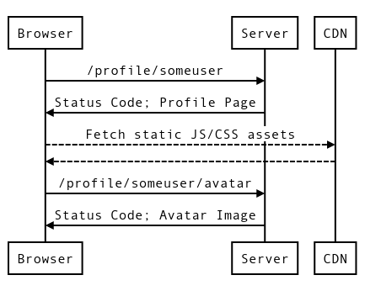
https://fangfactiongame.com/profile/someuser
SomeUser's Profile
Faction Name: | Tribe of Frog
Leader Name: | SomeUser
Email Address: | user@example.com
SomeUser
Tribe of Frog Faction Score: 31337
Midwest Canyon
1.
2.
3.
4.
5.
6.
Tri-Bool 65535
Tri Repetae 61995
Triassic Five 52391
Tricksy Hobbits 37164
Tribe of Frog 31337
Trite Examples 29243
Update
Notes:
Goal: Introduce "loading user profile" journey.
Points:
Slide shows:
Mock-up of a user's profile page
Sequence diagram of interactions to load page
Sequence diagram is also on page 18 of handout
Ask: What are user's expectations when they try to load this page?
Words:
I'm sure you can imagine a number of user journeys for this game. We're going to keep things simple for now, so we can step through the process without too many complicating factors, but you'll find some more complex journeys in your handout.
Our game allows players to log into their account via a web browser and keep track of their settlement while they aren't actively playing on their device. Here you can see a mock-up of what a player sees when they are logged into the game's website and open their profile page. On the right is a sequence diagram showing the requests and responses involved in serving this page to them. You can also find this on page 18 of your handout. The dotted lines are requests that are not observable from our serving infrastructure. What do you think their expectations are for this page? What would disappoint them, and make them think the service is not reliable?
Notes for presenter:
The players are probably going to expect things like:
The page loads in a reasonable time
They see their avatar image
They see their leader name, faction name and email address
They see the high scores for the area they're in
The CSS loads properly so the page looks right

Slide 54
Loading a Profile Page
Leaderboards
Web Server
Leaderboard
Generation
User Profiles
Load
Balancer
Game Servers
API Server
Notes:
Goal: How is the profile page served by our infrastructure?
Points/Words:
Here's how our infrastructure serves a profile page.
The player's HTTPS request is terminated at our load balancers, which forwards it to a pool of web servers.
That server looks up the player's profile in the user profile data store.
The profile contains most of the information displayed on the profile page, including the player's score and current location of their settlement.
The web server requests the leaderboard for that location from the leaderboard data store, then builds the HTML response for the player and sends it back.
When the player's browser subsequently requests their avatar, this request is served in much the same way.

Slide 55
SLI Menu
Request / Response | Availability Latency Quality
Data Processing | Coverage Correctness Freshness Throughput
Storage | Throughput Latency
Notes:
Goal: Pause and get audience to suggest SLIs.
Points/Words:
To begin figuring out what SLIs we should have for this journey, we ask ourselves:
What are the user's expectations for the reliability of this service?
How can we measure the user's experience versus those expectations with our monitoring systems?
How does the user interact with the service?
The SLI menu we're showing you here is a good place to start if you're not sure what kind of SLIs you should measure for a particular user journey. It's also on page 6 of your handout, so you can refer to it this afternoon.
Ask: Does anyone want to take a guess at what types of SLIs we want to measure for our user profile journey?

Slide 56
Availability
Latency
The profile page should load successfully
The profile page should load quickly
Notes:
Goal: Refining SLIs from specification to implementation.
Points:
Request/response ⇒ availability and latency
Words:
As this is a request/response interaction, we almost certainly want to measure the availability and latency experienced by players when they load the profile page. Put another way, they expect the profile page to load successfully and quickly.

Slide 57
Availability
Latency
The profile page should load successfully
The profile page should load quickly
How do we define success?
Where is the success / failure recorded?
How do we define quickly?
When does the timer start / stop?
Notes:
Goal: Refining SLIs from specification to implementation.
Points:
User expectations raise questions
Final SLI must be clearly defined and directly measurable
Words:
But these expectations raise questions: what does "successfully" and "quickly" really mean? It's important to be precise about the SLI definition. Your SLI should be clear about where it is measured, what is being measured (including any units), and what attributes of the underlying monitoring metrics are included or excluded. How can we define an SLI that answers these questions?

Slide 58
Availability
Latency
The profile page should load successfully
The profile page should load quickly
How do we define success?
Where is the success / failure recorded?
How do we define quickly?
When does the timer start / stop?
The proportion of valid requests served successfully.
The proportion of valid requests served faster than a threshold.
Notes:
Goal: Refining SLIs from specification to implementation.
Points:
User expectations translate to high-level SLI specifications—handout pages 7 and 8
Words:
Let's start with our high-level specifications from the handout. You can find these specifications, along with some guidance on how to develop availability and latency SLIs, on pages 7 and 8.
Our first problem is that our web servers serve way more than just profile page requests, but it's only these requests that are part of this particular user journey.

Slide 59
Availability
Latency
The profile page should load successfully
The profile page should load quickly
How do we define success?
Where is the success / failure recorded?
How do we define quickly?
When does the timer start / stop?
The proportion of valid requests served successfully.
The proportion of valid requests served faster than a threshold.
Notes:
Goal: Refining SLIs from specification to implementation.
Points:
First step: define what requests are valid
Use HTTP request path for this
Substitute definition into our specification
Words:
So let's define what attributes of a request make it valid for inclusion in our SLIs.
We identify profile page requests from the HTTP request path, which we know from our sequence diagram is either /profile/{user} or /profile/{user}/avatar. We also know the user's browser sends HTTP GET requests to these paths. So let's substitute these definitions in!

Slide 60
Availability
Latency
The profile page should load successfully
The profile page should load quickly
How do we define success?
Where is the success / failure recorded?
How do we define quickly?
When does the timer start / stop?
The proportion of HTTP GET requests for /profile/{user} or /profile/{user}/avatar served successfully.
The proportion of HTTP GET requests for /profile/{user} served faster than a threshold.
Notes:
Goal: Refining SLIs from specification to implementation.
Points:
Avatar included for availability, excluded for latency
Avatar latency is likely to be higher and more variable than
Bimodal latency distribution
Suggested words:
Here I've chosen to include avatar images in the availability SLI, but exclude them from the latency SLI.
Avatar images are uploaded by users and we don't know how large they'll be. We can realistically assume that images take longer to load than HTML. This means that including avatar image latency into our SLI would make the underlying latency distribution bimodal and introduce a lot of variance.
If you remember what we talked about earlier, this could cause problems when we're trying to set a latency SLO target, because we can't accurately target just one of the two loading times. Our users might be unhappy with a 500ms increase in page loading time, but that could still be less than the average time it takes to serve an avatar image, which they're still happy with in aggregate. Since the page is still broadly usable even before the avatar image loads, page loading time is the metric we care about more, so that's what we'll base our SLI on.

Slide 61
Availability
Latency
The profile page should load successfully
The profile page should load quickly
How do we define success?
Where is the success / failure recorded?
How do we define quickly?
When does the timer start / stop?
The proportion of HTTP GET requests for /profile/{user} or /profile/{user}/avatar served successfully.
The proportion of HTTP GET requests for /profile/{user} served faster than a threshold.
Notes:
Goal: Refining SLIs from specification to implementation.
Points:
HTTP status codes are an easy definition of "success"
Latency threshold is often easier to set alongside SLO target
Words:
Next, we need to be more specific about what "successfully" and "quickly" really mean. Our company just wants to get something simple measured quickly, so we're going to use the HTTP status code as an indicator of success.
The latency threshold is a bit harder. If you've got historical data, it's common to choose the cutoff point where requests are too slow in tandem with the SLO target that specifies what percentage of requests are allowed to be slower than the cutoff.
Optional:
Conceptually, there's an inverse s-curve relationship between user happiness and response latency. The latency threshold describes a point on that curve, and the SLO target describes what proportion of requests must be below that threshold for your users to remain happy, effectively reducing the s-curve to a step function. It can be valuable to approximate the s-curve more accurately by setting a second SLO targeting broad-based latency instead of long-tail, e.g. 75% of requests < 200ms and 99% of requests < 1s.

Slide 62
Availability
Latency
The profile page should load successfully
The profile page should load quickly
How do we define success?
Where is the success / failure recorded?
How do we define quickly?
When does the timer start / stop?
The proportion of HTTP GET requests for /profile/{user} or /profile/{user}/avatar that have 2XX, 3XX or 4XX (excl. 429) status.
The proportion of HTTP GET requests for /profile/{user} served within X ms.
Notes:
Goal: Refining SLIs from specification to implementation.
Points:
X ms is a placeholder, the SLI is technically incomplete
We're going to choose the threshold based on historical data in the back page of the handout
Status codes can be substituted in:
429 is "Too Many Requests"
Still need to decide where to measure
Suggested words:
Since the company has historical data for this particular endpoint, that's what we're going to do here with this "X milliseconds" construct. That makes this SLI implementation incomplete—you need a threshold to convert the latency distribution to a binary good/bad signal. We'll be asking you to figure out what thresholds are appropriate in a bit!
Rather than enumerate every possible code for our availability SLI, we'll assume that any 500-class codes are bad, and exclude 429s from our "good requests" too because it's what our servers return to users when they're overloaded.
But there's still one piece of the puzzle missing. We haven't said how or where we're going to measure any of this!

Slide 63
SLI Menu
Measurement Strategies | Application-level Metrics Logs Processing Front-end Infra Metrics Synthetic Clients/Data Client-side Instrumentation
Notes:
Goal: SLI implementation is mostly measurement strategy.
Points:
Five broad measurement strategies, none perfect
Creating SLI implementation is a key engineering decision
Using more than one measurement strategy is valuable—they can be complementary
Words:
Broadly speaking, there are five ways to measure an SLI, and none of them are perfect. Your handout has some details about the pros and cons of each. Making an informed engineering decision on which measurement strategy to use, based on the current needs of your service, is an important part of refining your SLI specification into concrete implementation.
It's entirely reasonable to use more than one strategy for each specification. For example, you may choose to use real-time metrics from your load-balancing infrastructure to drive short-term operational response, but base your long-term SLOs on reconstructing user journeys from session IDs in server-side logs.

Slide 64
Availability
Latency
The profile page should load successfully
The profile page should load quickly
How do we define success?
Where is the success / failure recorded?
How do we define quickly?
When does the timer start / stop?
The proportion of HTTP GET requests for /profile/{user} or /profile/{user}/avatar that have 2XX, 3XX or 4XX (excl. 429) status measured at the load balancer.
The proportion of HTTP GET requests for /profile/{user} that send their entire response within X ms measured at the load balancer.
Notes:
Goal: Refining SLIs from specification to implementation.
Points:
Sometimes we choose to trade off coverage and accuracy for ease of implementation.
These SLIs contain lots of explicit detail, and could be measured by a monitoring system.
Words:
In this case, the company decided the metrics provided by their load balancer were good enough to establish some initial SLIs without investing too much engineering effort. This is an entirely reasonable trade-off to make: your first SLIs are almost certainly going to need some improvement, so the sooner you start gathering data and begin the cycles of iteration, the better.
These final SLI implementations provide a lot of explicit detail about what exactly is being measured and how they are measured. If you give them to someone, they could actually build something that evaluates these metrics and gives you performance data!

Slide 65
Activity
Postmortem
Notes:
Instructors:
People will need a couple of minutes to scan the postmortem in the handout
The SLI did not verify that the response body contained good data
Ask: What action items would you suggest to close the measurement gap?
Wait on this slide for suggestions, next slide contains example answer
Words:
The problem with doing things quickly is that sometimes the corners you cut turn out to be sharp. If you check out the back of your handout, you'll find a brief postmortem for the Fang Faction game. The profile pages in the game were rendered incompletely, causing an outage that was not detected by the SLIs based on load balancer metrics. What action items would you suggest to close this measurement gap?

Slide 66
Availability
Latency
Proportion of HTTP GET requests for /profile/{user} or /profile/{user}/avatar that have 2XX, 3XX or 4XX (excl. 429) status measured at the load balancer
and
Proportion of HTTP GET requests for /profile/prober_user and all linked resources returning valid HTML containing "ProberUser" measured by a black-box prober every 5s
Proportion of HTTP GET requests for /profile/{user} that send their entire response within X ms measured at the load balancer
Notes:
Goal: Closing the coverage gap.
Points:
Additional availability SLI based on synthetic client
Validates that response body contains expected data
Can also test front-end request routing and CDN
This isn't the only option, but it's a good one
Words:
The way we've chosen to close the monitoring gap identified in the postmortem is to augment the load balancer metrics with a black-box prober which inspects and verifies the response body, but this is by no means the only way. This prober also validates that our front-end infrastructure is doing the right thing with request routing, and tests that our CDN is serving content correctly—two other gaps in the previous SLI. We augmented the current SLI with another one because only using a prober would reduce the coverage of the SLO: probing for one specific user is not measuring the general user experience.
While we've not chosen to measure a latency SLI with the prober, doing so would be easy. We avoided this because unless we run our prober in multiple, disparate places far removed from our infrastructure (think Pingdom), it's a strictly worse measure than the one derived from the load balancer metrics, which covers all user requests rather than those just made by the prober.

Slide 67
Do the SLIs cover the failure modes?
Availability
Latency
Availability
Black Box
Prober
Load
Balancer
Leader Boards
Web Server
Leaderboard
Generation
User Profiles
Game Servers
API Server
Notes:
Goal: Walk the user journey and ensure SLI covers it.
Points:
SLIs must capture the failure modes of your infrastructure, from the perspective of your users
Considering how your SLIs respond to infrastructure failure is important
Covering 100% of all conceivable failures is not feasible, do cost-benefit analysis
Words:
This outage illustrates why you should take a critical look at your infrastructure when creating your SLIs.
When we're considering the failure modes of our infrastructure, we're trying to answer four questions:
Can we measure the SLIs we've created where we want to measure them, given this infrastructure?
Do the SLIs adequately capture the user journey and its failure modes?
Are there any exceptions or edge cases to consider?
Do the SLIs capture multiple journeys with differing requirements?
We say "adequately capture" because reaching 100% coverage of all possible failure modes is again the wrong target.
Distributed systems fail in complex and surprising ways, so 100% is an unrealistic goal. If the failure mode is sufficiently rare that it won't eat more than a fraction of your error budget, then it's reasonable to argue that it's safe for your SLIs not to capture it. Failure modes that are outside of your control, and your users are unlikely to blame you for, are best left out of your SLIs. Things like failures at consumer ISPs or mobile phone carriers would fall into this bucket—you can't do much about them, but in some cases, it can be useful for your support teams to know they have happened.
You also have to perform some form of cost-benefit analysis. In some cases, extending your SLI to cover a particular failure mode could cost months of engineering effort and require re-architecting your service, your monitoring systems, or both—when building detailed client-side instrumentation from scratch, for example.
Instructors:
Depending on time here, get the audience to think about whether there are other failure modes that might not be captured by the current SLIs. The journey, once more:
To render the page, the player's http request must be routed by the load balancer to one of the web servers.
The player profile is loaded from the user profile data store.
The user profile contains their current area and score.
The leaderboard for the player's area is loaded from the leaderboards data store.
The response is assembled and returned to the user's browser.
The browser then requests the avatar image, which is served via similar means.

Slide 68
Activity
Define SLO Targets
Notes:
Instructors:
Historical monitoring data is on page 25 of the handout, right at the back
Next slide contains a table, so don't pause on this one
Please do not suggest that the graph showing latency percentiles aggregated over short periods of time (like the one we have in the booklet) can be used to determine whether the long-term SLO has been met. This is not possible. See this blog post for more details – and thanks, Heinrich!
Words:
We've got some graphs of historical monitoring data on page 25 of the handout, at the back, so we can take a shot at defining some achievable SLOs for this service.

Slide 69
What goals should we set for the reliability of our journey?
Your objectives should have both a target and a measurement window
Service | SLO Type | Objective
Web: User Profile | Availability
Web: User Profile | Latency
... | ...
99.95% successful in previous 28d
90% of requests < 500ms in previous 28d
Notes:
Goal: Get audience to suggest objectives.
Instructors:
Ask: what are some achievable SLO targets for this service?
ANIMATION WARNING: Objectives are revealed on click, so wait until the audience has reached consensus before clicking.
Words:
What targets do you think are justifiable given the previous six weeks of data? What measurement window would you measure this target over?

Slide 70
Fallen asleep yet?
Notes:
Instructors: Timing wise, should be just before the lunch break, about 2h in. Final pause for questions.

Slide 71
Break!
Notes:
Instructors: Hopefully "Lunch!" if you're doing this as an all-day thing :-)

Slide 72
Workshop: Let's develop some more SLIs and SLOs!
Follow the process we demonstrated for the Buy In-Game Currency journey:
Choose SLI specifications from the menu (see booklet, p6)
Substitute definitions in to create a detailed SLI implementation
Walk through user journey and look for coverage gaps
Set aspirational SLOs based on business needs
Once you're done, choose another journey as a group.
You have roughly 45 minutes for each journey.
Notes:
Instructors: Having gone through the example app and the process, the workshop itself is basically making the people in the room repeat the process twice more for themselves, while providing advice / guidance. There are five more complex, example user journeys in the handout. The next slide shows the architecture diagram. Once you've explained the process you'll want to advance to that and leave it up for people refer to.
Instructions for facilitating workshop:
Print out many copies of https://cre.page.link/slo-worksheet-print and distribute them. Walk the group through the example in the worksheet if you think they need a refresher on the content from this deck.
Walk through the user journeys from the handout. If there are enough people, divide the audience into groups of 4-5 people and ask each group to tackle the "Buy In-Game Currency" journey first, because we have a model answer for it later in the deck. It should take roughly 40-45 minutes to set some SLIs for this journey. If there's time for a second journey—there should be if you're doing a full-day event, we budget 90m for the practical exercise—then they can choose another one at random.
For each journey, walk through picking SLI Types (the "SLI Menu" may be helpful here). For each SLI Type, fill out the template in the SLO Worksheet, refining the SLI specification into an implementation. Consider the journey and where the SLI may not cover failure modes of the infrastructure. Finally, set aspirational SLO targets. This last part is the least important, any number with a reasonable justification is perfectly fine.

Slide 73

Our Game: Fang Faction
Leaderboards
Web Server
Leaderboard
Generation
User Profiles
Load
Balancer
Game Servers
API Server
Play
Store
Notes:
Instructors: Leave this slide up while people work, for reference.

Slide 74
Break!

Slide 75
Buy In-Game Currency
Model Answer
Notes:
Instructors: This part of the deck switches slides at a faster pace, it should only take 10-15 minutes to get through it. It's a cut-down version of the Train-the-Trainers deck.
Words:
We're now going to go through one possible set of SLIs and SLOs for the Buy In-Game Currency user journey.
I want to stress that this isn't the only answer! I expect you all will have come up with something different before the break. This is just to provide a frame of reference and show how the process we went through in the slides can be applied to more complex journeys too.

Slide 76
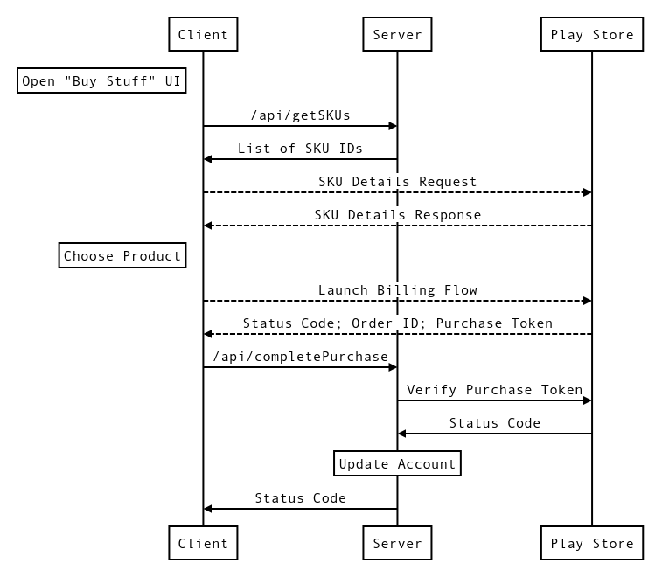
Break Down
The Journey
Five request/response pairs
Fetch list of SKUs from API server
Fetch SKU details from Play Store
User launches Play billing flow
Send token to API server
Verify token with Play Store
1
2
3
4
5
Notes:
Words:
Let's take a look at the journey, so we can figure out what SLIs we're going to want for it. There are five request-response pairs involved in someone buying in-game currency.

Slide 77
Break Down
The Journey
Journey has two parts. A: Fetch SKUs
Fetch list of SKUs from API server
Fetch SKU details from Play Store
User launches Play billing flow
Send token to API server
Verify token with Play Store
1
2
Notes:
Words:
But they're not all equivalent—there are two distinct parts to the journey. First, when the user opens up the in-game "store", the game client has to ask our servers what items are available to purchase, then it has to retrieve details like pricing information from the Play store. Both of these things have to happen successfully for the client to be able to display the store UI to the user.
Note: SKUs are stock keeping units

Slide 78
Break Down
The Journey
Journey has two parts. B: Buy Item
Fetch list of SKUs from API server
Fetch SKU details from Play Store
User launches Play billing flow
Send token to API server
Verify token with Play Store
3
4
5
Notes:
Words:
The second part of the journey occurs after the user chooses a particular item to buy. This triggers the Play Store's "billing flow", which takes control of the device away from the app and gives it to the Play Services framework. The Play Services framework handles things like taking credit card details and talking to the Play Store to charge the user for the item they've chosen. The billing flow returns a status code, and if the purchase was successful there will also be an order ID and purchase token. Our servers need to know about successful purchases so we can grant the item the user has chosen to them. Therefore, the device sends the order ID and purchase token to our servers via the completePurchase API call. We have to validate the purchase token with the Play Store before giving the user their item, to prevent double-spend attacks.

Slide 79
Break Down
The Journey
User might choose not to buy an item :-(
Fetch list of SKUs from API server
Fetch SKU details from Play Store
User launches Play billing flow
Send token to API server
Verify token with Play Store
We have to treat these parts separately!
1
2
Notes:
Words:
Breaking the journey down like this is important, because we are not going to get anything like a 100% conversion rate when people open up our in-game store. Anecdotally, numbers in the 1-2% range are much more realistic. If we were to create SLOs for the entire journey as a whole, the difference in traffic between the two parts would cause any signal from the second part of the journey to be swamped by the first. And arguably the second part is more important because it's the source of all our company's revenue.

Slide 80
Break Down
The Journey
Two requests don't hit API server at all!
Fetch list of SKUs from API server
Fetch SKU details from Play Store
User launches Play billing flow
Send token to API server
Verify token with Play Store
Server or load balancer metrics may not give enough coverage of the journey :-(
2
3
Notes:
Words:
Another thing to consider is that there are two request-response interactions that occur between the user's device and the Play Store. Our serving infrastructure will not see these requests, so we will not be able to measure them except via client-side telemetry, or at a pinch via a synthetic client.

Slide 81
Break Down
The Journey
Two requests don't hit API server at all!
Fetch list of SKUs from API server
Fetch SKU details from Play Store
User launches Play billing flow
Send token to API server
Verify token with Play Store
Server or load balancer metrics may not give enough coverage of the journey :-(
… we'll have to ask our users to consent
to client-side telemetry.
2
3
Notes:
Words:
And if we're going to have our game client report statistics back to us, it's very important that we get the consent of our users beforehand. This is commonly done with a one-time pop-up dialog asking users whether they want to report crashes and other statistics back to our company for the purposes of product improvement, along with a description of the sort of data being collected. Contact your friendly neighborhood lawyer for more information!

Slide 82
Buy Flow
What SLIs?
Buy Flow journey is
Request / Response
SLI menu suggests we use
Availability and Latency SLIs
Notes:
Words:
Now we've considered the sequence of interactions that make up the user journey, we can decide on the SLIs we want to measure for it. The SLI menu suggests Availability and Latency SLIs, because all of our interactions are HTTP requests.

Slide 83
Buy Flow Availability:
Specification
B makes money, so let's start with that
Fetch list of SKUs from API server
Fetch SKU details from Play Store
User launches Play billing flow
Send token to API server
Verify token with Play Store
Availability SLI Specification
The proportion of valid requests
served successfully.
3
4
5
Notes:
Words:
We'll want availability and latency SLIs for both parts of the journey, but because the second part is where we actually take money off our users and give them things, that's what we'll focus on first. Just like the user profile journey, we can start from the generic availability SLI specification, which is simply "the proportion of valid requests served successfully". Figuring out good definitions for "valid" and "successful" will turn this into something that we could implement in a monitoring system.

Slide 84
Buy Flow Availability:
Valid Requests
Availability SLI
The proportion of valid requests
served successfully.
… but which requests are valid?
User launches Play billing flow
Send token to API server?
Verify token with Play Store?
Launching the billing flow indicates
a user's intent to buy a product
Users consenting to client-side telemetry
collection allows us to track this intent
3
Notes:
Words:
When deciding which requests to include or exclude from our SLI, it's important to think about the user and their expectations. In this case, when the user clicks on one of our products, they are expressing a clear intent to buy that product, and they expect that we will sell it to them. If they get an error instead, they will not be happy and we will have forfeited some potential revenue. The first usefully measurable event that occurs once that button has been pressed is the launch of the Play Store's billing flow, so we'll consider any launches of this flow to be requests we should include into our SLI. We can only track this on our users devices, so we will have to ask for the user's permission to track and record this data.

Slide 85
Buy Flow Availability:
Success Criteria
Availability SLI
The proportion of launched billing flows
from users consenting to collection
served successfully.
… and how do we determine success?
All interactions must be successful!
Good status code; purchase token
Good status code; account updated
Good status code; valid token
Return 402 to API call when token is invalid
3
4
5
Notes:
Words:
Oh dear. Our SLI is already quite a mouthful when we substitute in that definition of validity, and we still need to define "successfully" in this context. For the user to get the product they intended to purchase, all of the interactions in the journey must complete successfully. Success for the billing flow means that we get a "good" status code back from the Play Store and a purchase token if the purchase was successful. Similarly, for the completePurchase call, the server needs to respond with a "good" status code, and it needs to update the user's account to give them the product they purchased.
The interaction between our servers and the Play Store to validate the purchase token isn't visible from the client. It's useful to measure both valid requests and successful requests in the same place so that it's harder for discrepancies to creep in. We'll report failures in token validation back to the client with specific HTTP status codes to bridge this gap. Specifically, when the Play Store tells us the purchase token is invalid, we'll send a 402 "Payment Required" code back to the client. This won't be counted as a failure by the SLI—chances are that invalid tokens are people attempting replay attacks—but the client will be able to display a meaningful error to the user.

Slide 86
Buy Flow Availability:
Measurement
Availability SLI
The proportion of launched billing flows
from users consenting to collection
where the billing flow returns:
OK and a purchase token
or FEATURE_NOT_SUPPORTED
or ITEM_UNAVAILABLE
or USER_CANCELED
and /api/completePurchase returns:
200 OK and Parseable JSON
or 402 Payment Required
… but where are we measuring this?
3
4
Notes:
Words:
When we substitute in our definition of success, the SLI is almost complete: we just need to describe where its components will be measured. As we noted earlier, it's important to be specific and detailed about exact status codes. The constants in CAPITAL_LETTERS are response codes from the Play Store's documentation. Hopefully "OK" is obvious, but the others are worth a brief explanation.
FEATURE_NOT_SUPPORTED means that the user's device is running a version of Android or the Play Store app that is too old. The server-side parts of the Play Store are no longer able to support purchases from the device.
ITEM_UNAVAILABLE is basically a race condition: between the user listing the SKU details from the Play Store and trying to buy a particular product, we took down the product from the Play Store so it was no longer available to purchase.
USER_CANCELED is the user giving up and no longer wanting to buy the product in question. All of the various permutations of credit card expiry or other payment failures roll up into this, because the Play Store's billing flow will simply keep prompting users for a valid payment method until either it manages to charge them for the product or they give up and cancel the purchase.

Slide 87
Buy Flow Availability:
Measurement
Availability SLI
The proportion of launched billing flows
from users consenting to collection
where the billing flow returns:
OK
or FEATURE_NOT_SUPPORTED
or ITEM_UNAVAILABLE
or USER_CANCELED
and /api/completePurchase returns:
200 OK
or 402 Payment Required
and Parseable JSON
measured by the game client and
reported back asynchronously.
3
4
Notes:
Words:
The constraints we've already discussed mean we have to measure this SLI on the client. Adding this on the end is a formality, but an important one, because all SLI implementations should be clear about where and they are measured.

Slide 88
Buy Flow Latency:
Specification
We want to measure latency for B too!
Fetch list of SKUs from API server
Fetch SKU details from Play Store
User launches Play billing flow
Send token to API server
Verify token with Play Store
Latency SLI Specification
The proportion of valid requests
served faster than a threshold.
3
4
5
Notes:
Words:
We can use the same process of mechanical substitution to develop a latency SLI for our purchases too, starting from the generic latency SLI specification "the proportion of valid requests served faster than a threshold".

Slide 89
Buy Flow Latency:
Valid Requests
Latency SLI
The proportion of valid requests
served faster than a threshold.
… but which requests are valid?
User launches Play billing flow?
Send token to API server
Verify token with Play Store?
Why not 3?
Too variable, SLI will have poor SnR
Billing flow contains lots of "poking
device with a finger" time
4
Notes:
Words:
Measuring the latency of the entire billing flow won't work for us, because while the user's device is running the billing flow our app has to relinquish control. If we're measuring the entire flow, but, say, the user needs to add a new credit card because the one they had used previously expired, we'll include that time where the user is poking at their screen in our measurements. This makes our metric highly variable; as we discovered earlier, this results in an SLI with a poor signal-to-noise ratio.
Instead, we'll measure the latency of the requests to /api/completePurchase. These are served by systems we control and should have a consistent latency profile, so our SLI will provide a strong signal and we can take concrete action if it deteriorates.

Slide 90
Buy Flow Latency:
"Too Slow" Threshold
Latency SLI
The proportion
of /api/completePurchase requests
served faster than a threshold.
… and what is fast enough?
Rough estimate time!
Verify Token <= 500ms
Database Write <= 200ms
Round up a bit…
Notes:
Words:
That's easy to substitute in. But what is "fast enough" for these requests?
Because this is a fictional example, we don't have any historical data on the performance we can achieve in practice, nor users who might have expectations about how fast we can serve responses. Instead we'll have to make an educated guess about what our systems might be able to achieve, and try to justify those estimates. If we're only setting a single latency SLI we should target the long tail, most requests should be served substantially faster than these thresholds.

Slide 91
Buy Flow Latency:
Measurement
Latency SLI
The proportion
of /api/completePurchase requests
served within 1000ms.
… but where are we measuring this?
Where does the timer start/stop?
Notes:
Words:
An important facet of engineering is carefully padding your estimates to give yourself a safety margin. In this case we've opted to round our latency threshold up to a second, and we'd probably pair this with a 95% or 99% SLO target.
We have a lot more flexibility around where we can measure this SLI, because we're not constrained by the need to measure requests that are only observable from the client.

Slide 92
Buy Flow Latency:
Measurement
Latency SLI
The proportion
of /api/completePurchase requests
where the complete response is
returned to the client within 1000ms
measured at the load balancer.
Notes:
Words:
A good rule of thumb for latency SLIs is to measure at the closest point to the user which is still under your direct control, which in practice usually means at your load balancers. Measuring closer to the user than this usually means incorporating the round-trip time from wherever that user is on the internet to wherever your service is hosted. This is undesirable because it introduces a lot of variability into the measured latency, decreasing the signal-to-noise ratio of the resulting SLI.

Slide 93
A brief word from
our sponsors...
Notes:
Of course, this wouldn't be a Google presentation without some advertising...

Slide 94
https://cre.page.link/art-of-slos
Notes:
Words:
First, all of the content for this workshop is freely available online under the Creative Commons CC-BY-4.0 license. So if you've found today interesting and you'd like to be able to run an Art of SLOs workshop for your business or at a conference, head to https://cre.page.link/art-of-slos to get hold of the slides and handbooks.

Slide 95
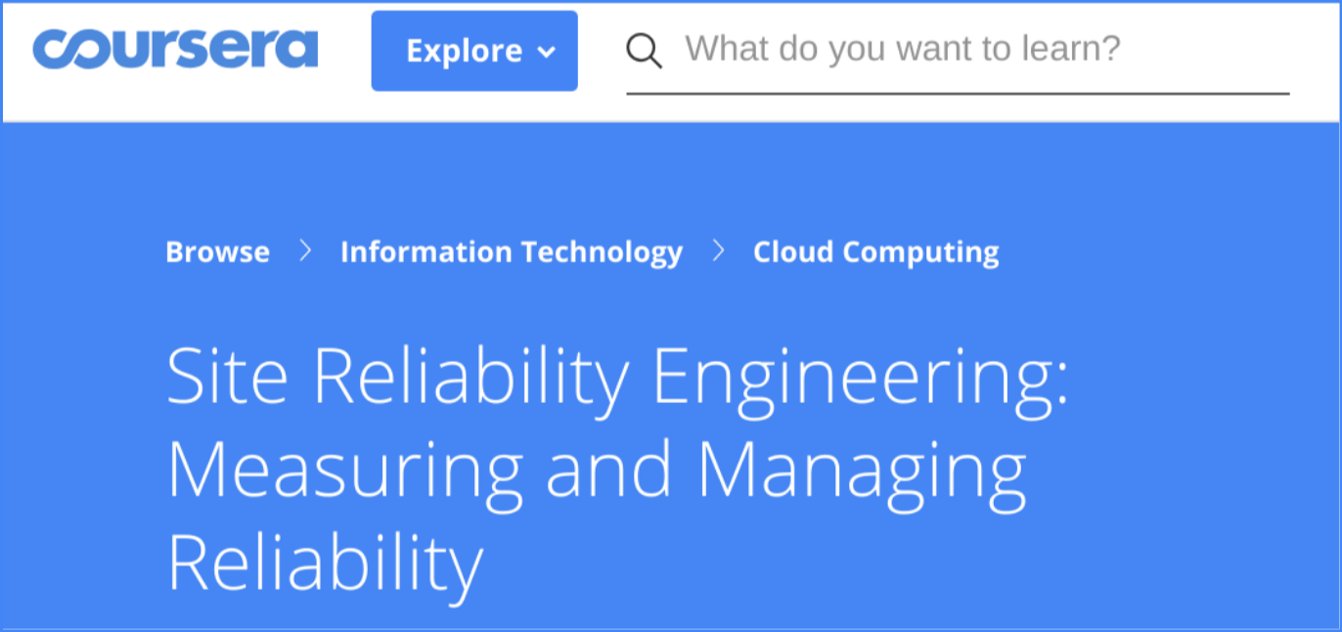
Want to learn more about SLOs? Take our course on Coursera:
https://cre.page.link/coursera
Notes:
Words:
Also, we offer a more in-depth version of today’s material on Coursera. This is great if you want to spread SLO culture in your company, but you want people to be able to study at their own pace.

Slide 96
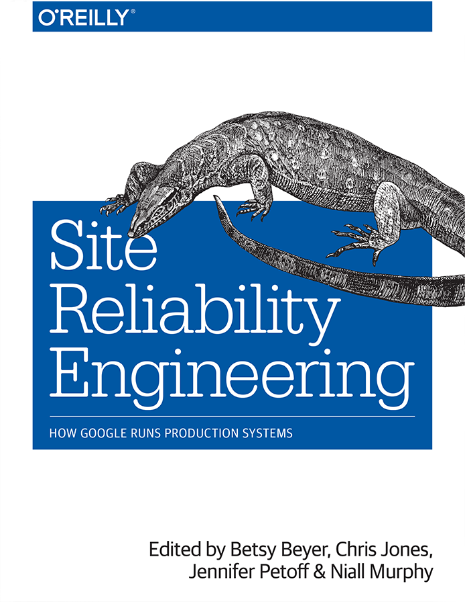
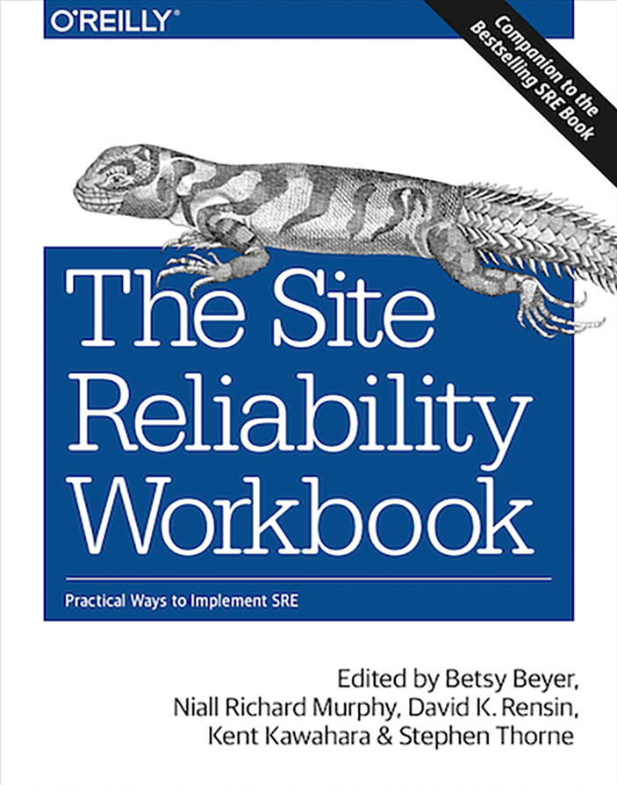
Both of these are now available in HTML format for free!
https://landing.google.com/sre/books/
Notes:
Finally, both the SRE book and the Site Reliability Workbook are available on google.com/sre for you to read for free!

Slide 97
Insert QR code link
to feedback form
in this space!
Insert QR code link
to feedback form
in this space!
Thanks!
Please fill in the feedback form

Slide 98
Q&A
Please ask our panelists questions!
Notes:
Pro tips:
Ask people to give their name and the company / team they're from before asking their question!
Have one of the facilitators record all the questions for the retrospective.

